Slide 1

FRSchools
Team Falcon: Sanath Sridhar, Taher Saifi, Niyati Ghagada,
Anamika Kannoly, Mayur Devadiga, Prithvika Babu, Samiksha Arun, Nihal Patil

Slide 2

Problem?
In schools, caretakers and admins often have the task of taking attendance of kids and registering them into the system. However, this task is done manually by hand, and this often results in a waste of manpower, time as well as resources. In the UAE, there had been a tragic event in which a child had died inside a bus due to the negligence of the driver has locked the bus not knowing the child was there, because of a mistake in the attendance sheet. Many issues happen due to this inefficient method of manually keeping track and registering the kids into the system and out of it.
SO WHATS THE SOLUTION?

Slide 3

THE SOLUTION
Using facial recognition to automatically register in and record attendance data of kids from the system.
Our solution eliminates the need for tedious manual tracking of students on/off boarding the bus with the help of our facial recognition system and FRS app. They completely reduce the risk of wrong attendance as its automatic and quick, the driver in the bus can know the total count once all students have boarded the bus such as if any absent or not boarded yet. This data is notified and recorded on the application where the parents are notified and can see it. This helps parents and drivers/caretakers keep track of students during their journey from home to school and vice versa. The case mentioned in the problem slide tells us how important it is to have such technology for the safety and security of the children.

Slide 4





How this application works

Slide 5
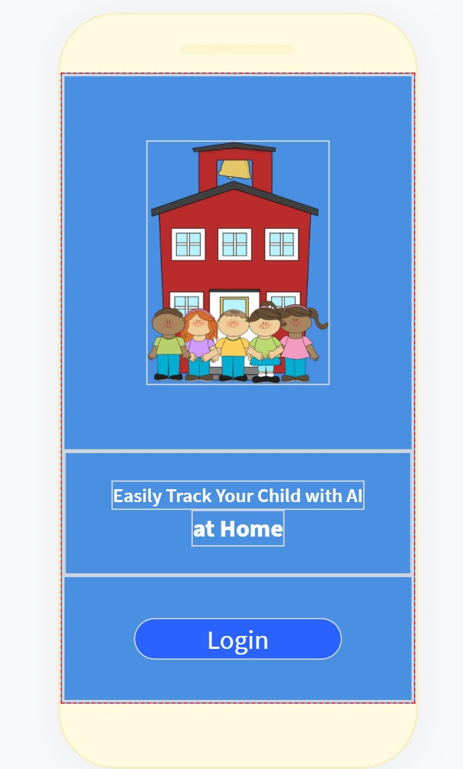
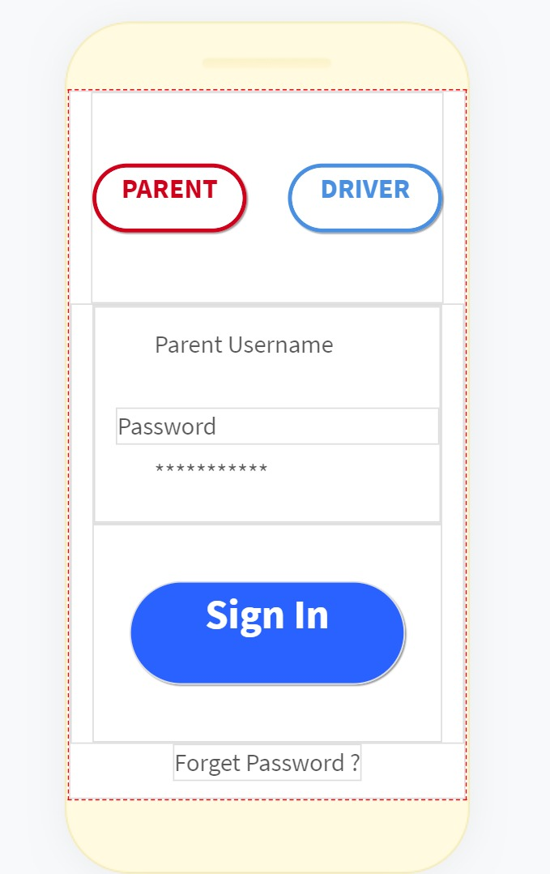
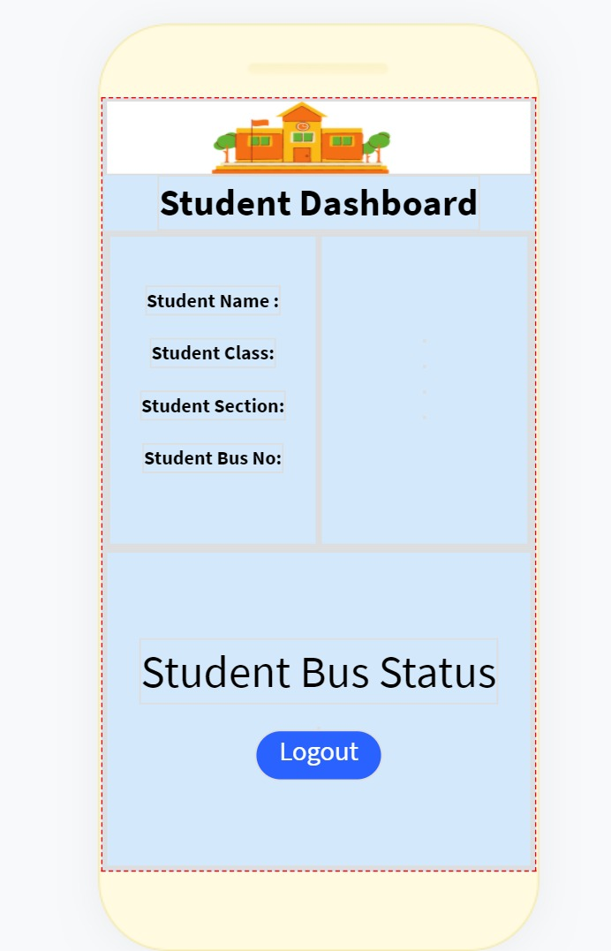
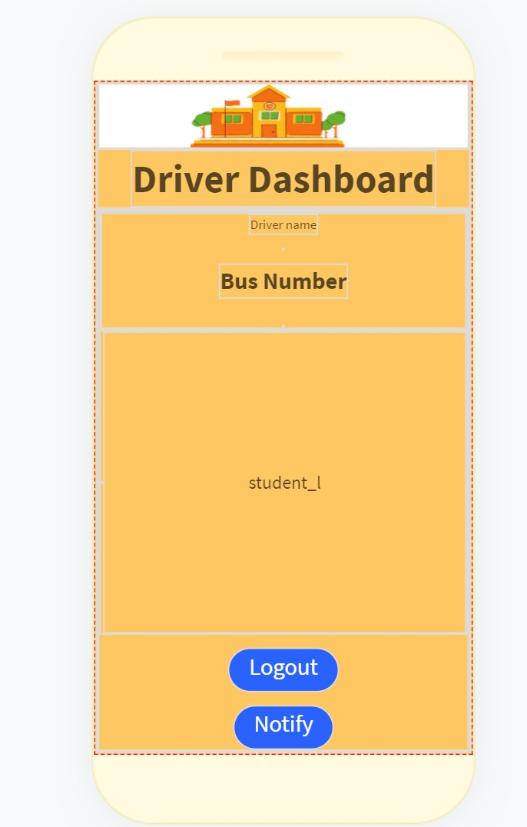
UI INTERFACE

Slide 6
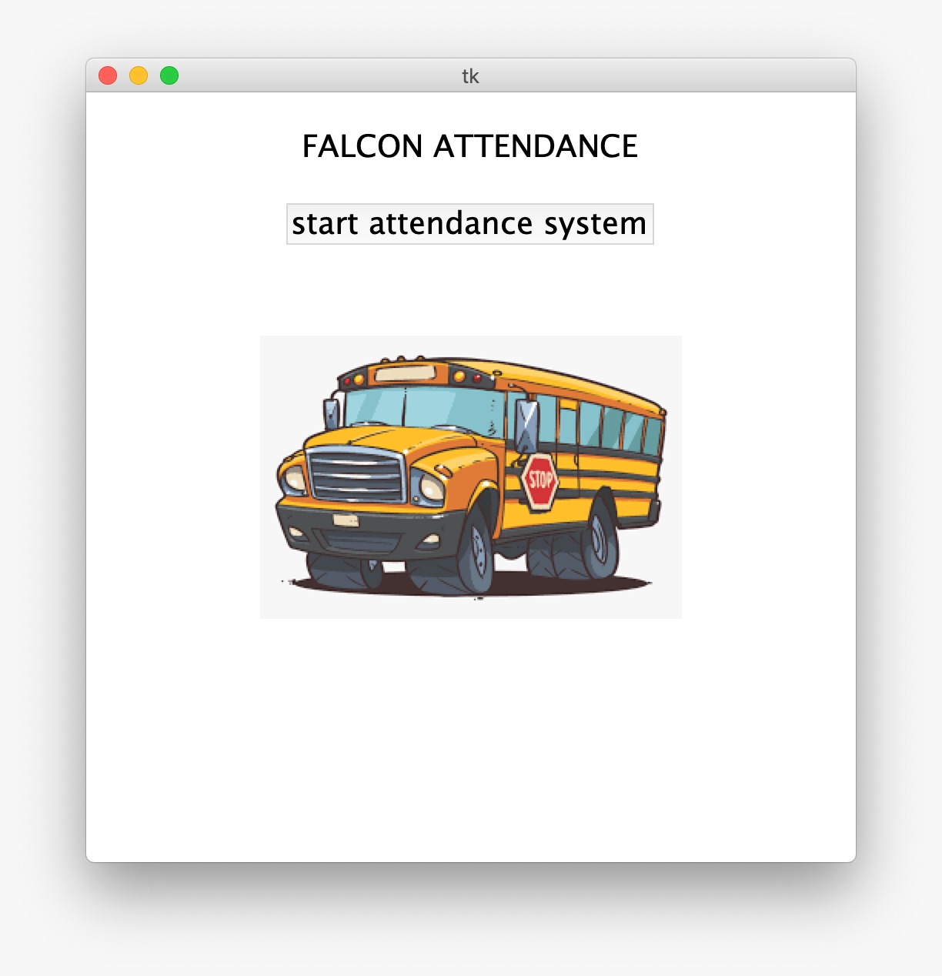
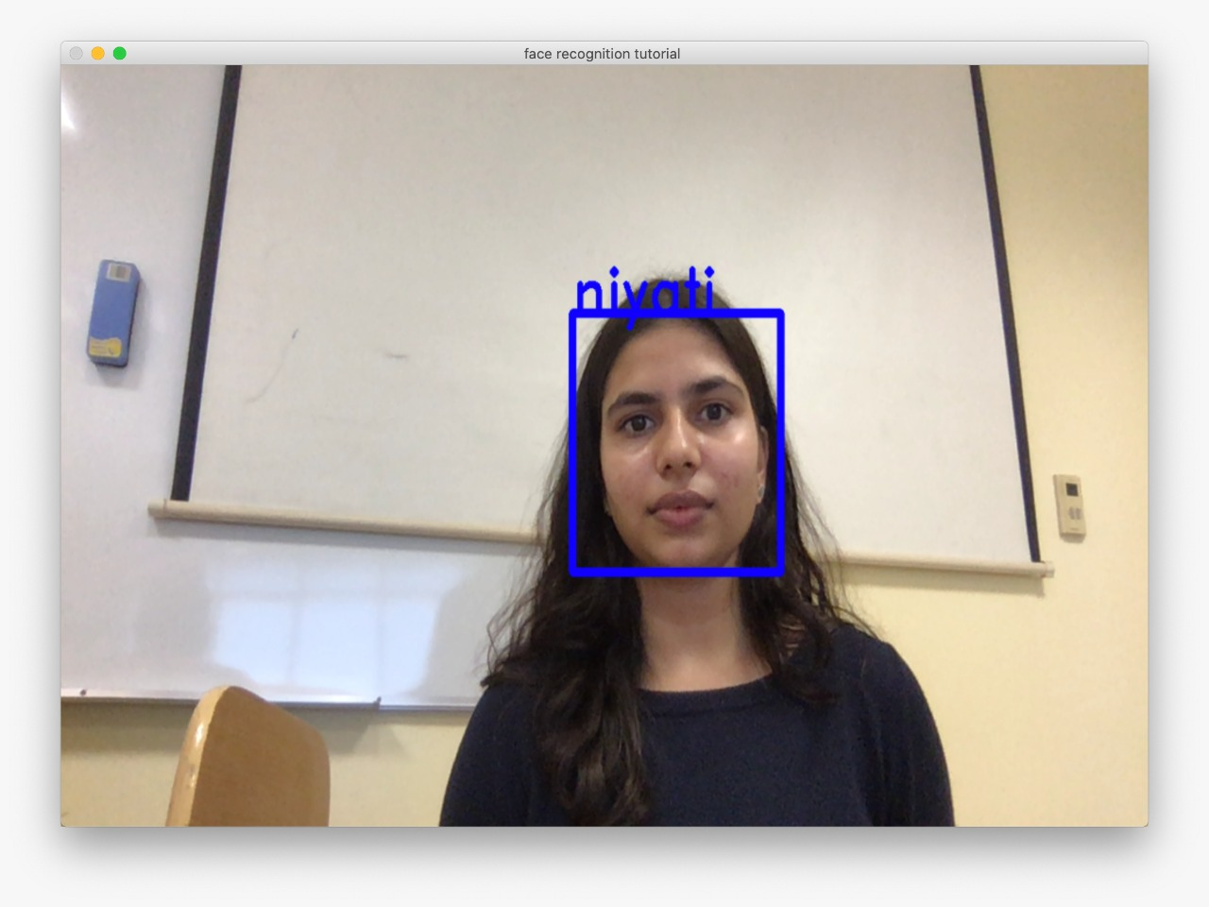
Admin UI Interface

Slide 7
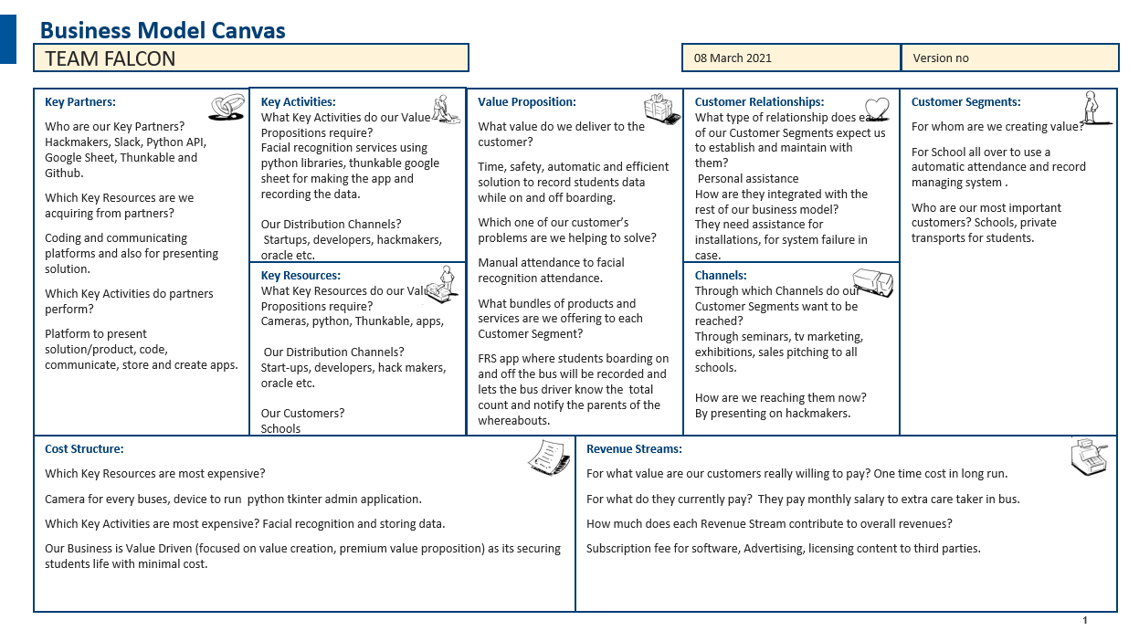
Business Model

Slide 8

Why this product?
It is human nature to make mistakes but when it comes to tasks like keeping track and registering, things can get quite clumsy. With the latest technology and AI, we present an advanced product that saves a lot of time, energy and resources by doing these tasks automatically, with a very easy installation procedure.
With facial recognition registration feature, schools can easily register and track the students, and will always be able to have a guaranteed answer ready for the parents on their children’s whereabouts. Moreover, attendance can be taken faster, and this provides more time for studies and other activities.
Not only does this end here, but our application is constantly evolving and with each update, there’ll be more features and faster services.

Slide 9

Why choose us?
Facial recognition is an emerging technology and there is no doubt that numerous other companies are implementing it. However, due to our specialization and expertise in the field of facial recognition registration, our technology makes it simple and fast to recognize a face and register in and out of the system.
With our well-known partners, who are GitHub, Slack, etc., we collaborated on a very simple yet efficient application that’s bound to make tasks automatic and change the world.
This Photo by Unknown Author is licensed under CC BY

Slide 10
THANK YOU

